Slide 1
Stresses Analysis of Gear
Tribhuwan University
Institute of Engineering
Pulchowk Campus
Tutorial By:
Nipesh Regmi
Department of Mechanical Engineering

Slide 2
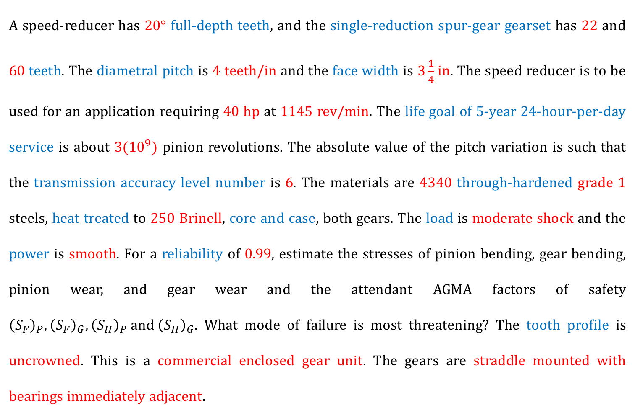

Stress Analysis of SPUR GEAR
A speed-reducer has $20°$ full-depth teeth, and the single-reduction spur-gear gearset has 22 and 60 teeth. The diametral pitch is 4 teeth/in and the face width is $3\frac{1}{4}$in. The speed reducer is to be used for an application requiring 40 hp at 1145 rev/min. The life goal of 5-year 24-hour-per-day service is about $3({10}^{9})$ pinion revolutions. The absolute value of the pitch variation is such that the transmission accuracy level number is 6. The materials are 4340 through-hardened grade 1 steels, heat treated to 250 Brinell, core and case, both gears. The load is moderate shock and the power is smooth. For a reliability of 0.99, estimate the stresses of pinion bending, gear bending, pinion wear, and gear wear and the attendant AGMA factors of safety ${\left(S_{F}\right)}_{P},{\left(S_{F}\right)}_{G},{\left(S_{H}\right)}_{P} and{ \left(S_{H}\right)}_{G}.$ What mode of failure is most threatening? The tooth profile is uncrowned. This is a commercial enclosed gear unit. The gears are straddle mounted with bearings immediately adjacent.

Slide 3
Stress Analysis of SPUR GEAR
MACHINE DESIGN DATA HANDBOOK
START WITH EQUATION 6.3
Notes:
Diametral Pitch (P), teeth per inch:
The ratio of the number of teeth on the gear to the pitch circle diameter. Used only with U.S. units.
Module, m:
The ratio of the pitch circle diameter to the number of teeth. Used in SI system. It has unit of mm.

Slide 4
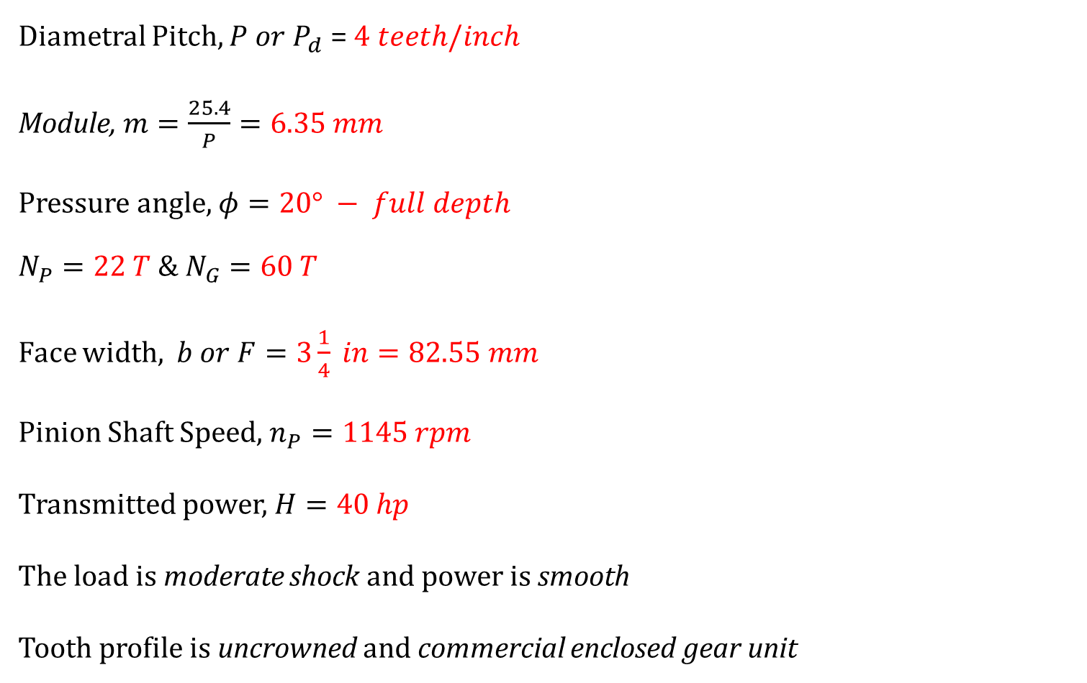
Stress Analysis of SPUR GEAR
Diametral Pitch, $P or P_{d}$ = $4 teeth/inch$
Module, $m=\frac{25.4}{P}=6.35 mm$
Pressure angle, $φ=20° − full depth$
$$N_{P}=22 T \& N_{G}=60 T$$
Face width, $b or F=3\frac{1}{4} in=82.55 mm$
Pinion Shaft Speed, $n_{P}=1145 rpm$
Transmitted power, $H=40 hp$
The load is moderate shock and power is smooth
Tooth profile is uncrowned and commercial enclosed gear unit
Gears are straddle mounted with bearings immediately adjacent

Slide 5
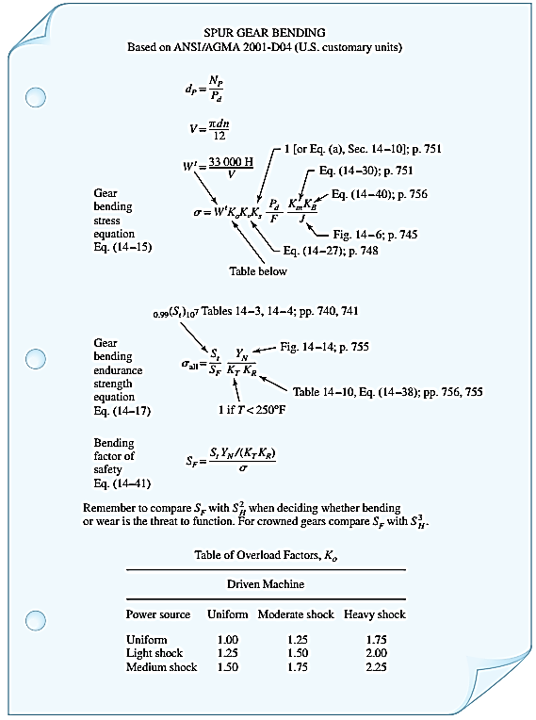




SPUR GEAR BENDING PROCEDURE
Eq. 6.3 (I)
Eq. 6.3 (V)
Eq. 6.3 (II)
Eq. 6.3 (VI)
Eq. 6.3 (VII)
Fig. 6.3
Eq. 6.3 (IX)
Eq. 6.3 (IV)
Table 6-1
$S_{t}$ : Eq. 6.7.1 (a)
$Y_{N}$ : Eq. 6.7.1 (b)
$K_{T}$ : Eq. 6.7.1 (c)
Eq. 6.7.1
$K_{R}$ : Eq. 6.7.1 (d)
Notes:
Diametral Pitch (P), teeth per inch:
The ratio of the number of teeth on the gear to the pitch circle diameter. Used only with U.S. units.
Module, m:
The ratio of the pitch circle diameter to the number of teeth. Used in SI system. It has unit of mm.

Slide 6
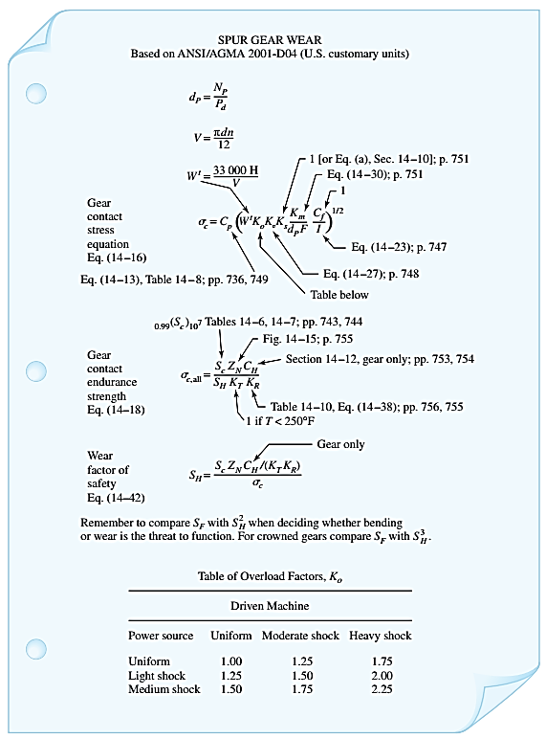



SPUR GEAR WEAR PROCEDURE
Eq. 6.3 (I)
Eq. 6.3 (V)
Eq. 6.3 (II)
Eq. 6.3 (VI)
Eq. 6.7.2 e (ii)
Eq. 6.7.2 e (iii)
Eq. 6.7.2 (e)
Eq. 6.3 (IV)
Eq. 6.7.2 e (i), Table 6-6
Table 6-1
$S_{c}$ : Eq. 6.7.2 (a)
$Z_{N}$ : Eq. 6.7.2 (b)
Eq. 6.7.2
$C_{H}$ : 1.005
Notes:
Diametral Pitch (P), teeth per inch:
The ratio of the number of teeth on the gear to the pitch circle diameter. Used only with U.S. units.
Module, m:
The ratio of the pitch circle diameter to the number of teeth. Used in SI system. It has unit of mm.

Slide 7

Pitch diameters
Pitch Diameters, $d_{P} \& d_{G}$
$$d_{P}=mN_{p}=139.7 mm$$
$$d_{G}=mN_{G}=381.0 mm$$

Slide 8

Velocity, V
$V=πdn$ (m/s)
$$=πd_{p}n_{p}$$
$=$ $π\left(0.1397\right)\left(\frac{1145}{60}\right)$
$$=8.375 m/s$$

Slide 9

Transmitted lOad, W^{t}
$W^{t}=\frac{0.7457×1000×H(hp)}{V}$ (N)
$$=\frac{0.7457×1000×40}{8.375}$$
$$=3561.552 N$$

Slide 10
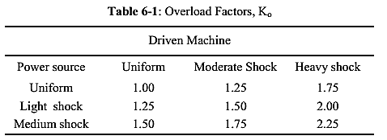

Overload Factors k₀
$$K_{0}=1.25$$
Load “Moderate shock”
Power “Smooth”

Slide 11
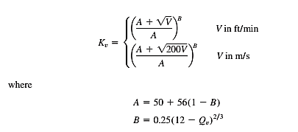
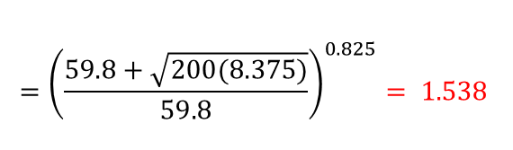
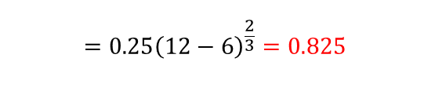


Dynamic factor, k_{v}
$$={\left(\frac{59.8+\sqrt{200(8.375)}}{59.8}\right)}^{0.825}= 1.538$$
$$=50+56\left(1−0.825\right)=59.8$$
$$=0.25{\left(12−6\right)}^{\frac{2}{3}}=0.825$$
For our problem,
Quality Level, $Q_{v}=6$

Slide 12



Size factor, k_{s}
$${\left(K_{S}\right)}_{P}=0.904{\left(82.55×6.35×\sqrt{0.331}\right)}^{0.0535}$$
$$=1.227$$
$${\left(K_{S}\right)}_{G}=0.904{\left(82.55×6.35×\sqrt{0.422}\right)}^{0.0535}$$
$$=1.235$$
We have,
$b = 82.55 mm$
$m = 6.35 mm$
$Y = ???$
Y for Pinion = 0.331
Y for Gear = 0.422

Slide 13
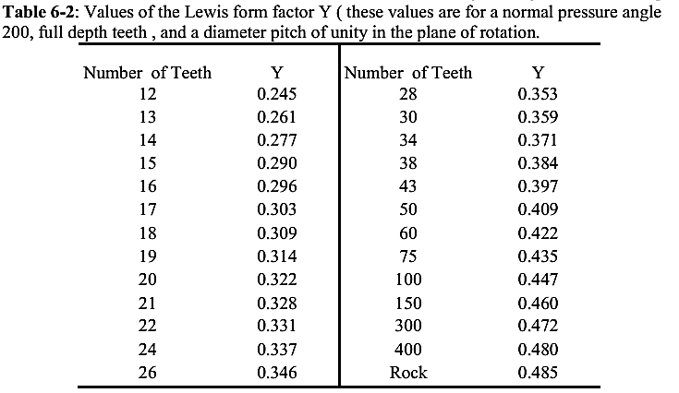

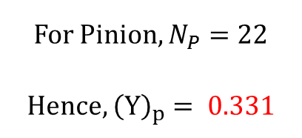
Lewis form factor, Y
For Pinion, $N_{P}=22$
Hence, ${\left(Y\right)}_{p}= 0.331$
For Gear, $N_{G}=60$
Hence, ${\left(Y\right)}_{G}= 0.422$

Slide 14

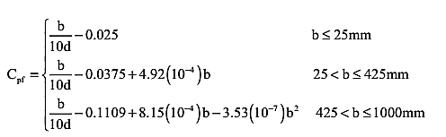

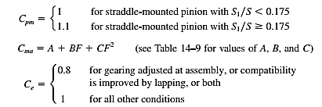
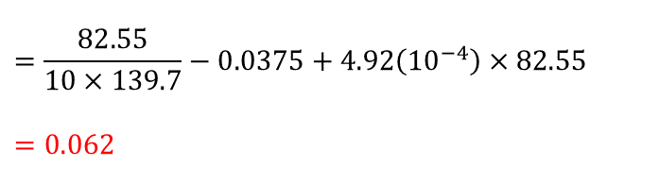




Load distribution factor, k_{H} or k_{m}
$$=1+1\left(0.062×1+0.177×1\right)=1.239$$
$$=\frac{82.55}{10×139.7}−0.0375+4.92\left({10}^{−4}\right)×82.55$$
$$=0.062$$
Since, $b=82.55 mm$
$$C_{mc}=1$$
$$C_{pm}=1$$
$$=0.127+0.0158\left(3.25\right)−0.930\left({10}^{−4}\right){\left(3.25\right)}^{2}=0.177$$
Table 6-3
$$C_{e}=1$$

Slide 15
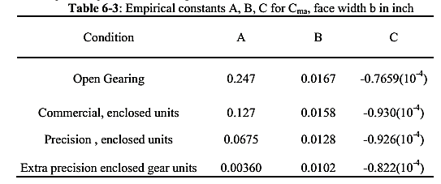
Load distribution factor, k_{H} or k_{m}
Gears are commercial, enclosed units
A = 0.127; B = 0.0158 and C = -0.930 (10⁻⁴)

Slide 16

Rim Thickness factor, k_{B} or k_{R}
$$Rim Thickness Factor, K_{B}=1$$

Slide 17
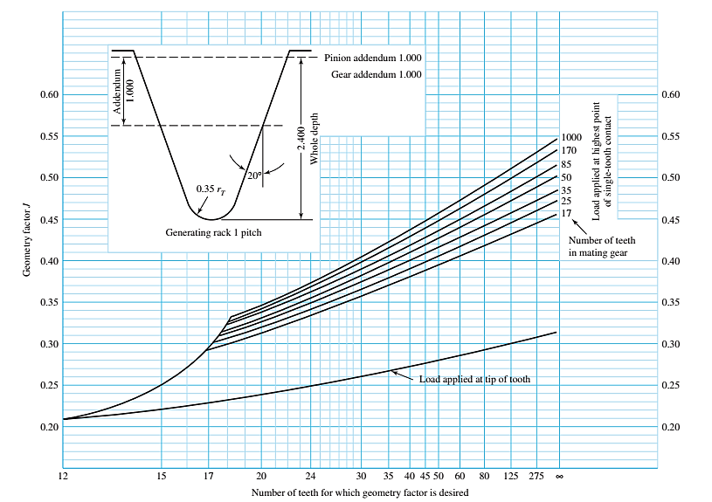
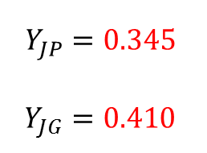

Bending Strength Geometry factor, Y_{j} or J
$$N_{P}=22 and N_{G}=60$$
$$Y_{JP}=0.345$$
$Y_{JG}=0.41$0
0.41
0.345

Slide 18




Bending Stress, $σ$
$$σ_{P}={\left(W^{t}K_{0}K_{V}K_{s}\frac{1}{bm_{t}}\frac{K_{H}K_{B}}{Y_{J}}\right)}_{P}$$
$$=(3561.552)(1.25)(1.538)(1.227) \frac{1}{(82.55)(6.35)}\frac{(1.239)(1) }{0.345}$$
$$=57.559 MPa$$
$$σ_{G}={\left(W^{t}K_{0}K_{V}K_{s}\frac{1}{bm_{t}}\frac{K_{H}K_{B}}{Y_{J}}\right)}_{G}$$
$$=(3561.552)(1.25)(1.538)(1.235) \frac{1}{(82.55)(6.35)}\frac{(1.239)(1) }{0.410}$$
$$=48.749 MPa$$

Slide 19
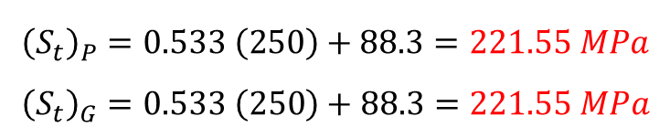

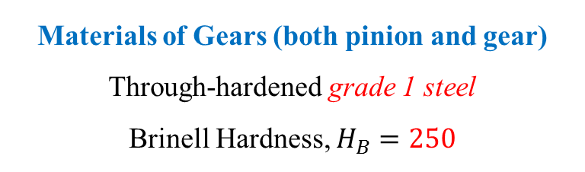
Allowable Bending Strength, $S_{t}$
Materials of Gears (both pinion and gear)
Through-hardened grade 1 steel
Brinell Hardness, $H_{B}=250$
$${\left(S_{t}\right)}_{P}=0.533 \left(250\right)+88.3=221.55 MPa$$
$${\left(S_{t}\right)}_{G}=0.533 \left(250\right)+88.3=221.55 MPa$$

Slide 20
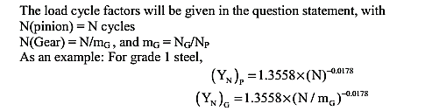
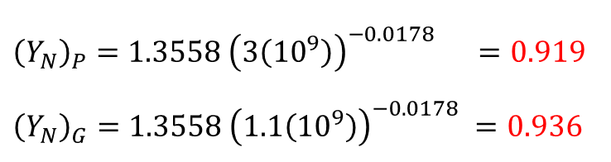



Stress-Cycle factor, $Y_{N}$
Where,
$m_{G}=\frac{N_{G}}{N_{P}}$
$$=\frac{60}{22} \\ =2.73$$
For our problem,
$$N\left(Pinion\right)=3\left({10}^{9}\right) revolutions$$
$$N\left(Gear\right)=\frac{N\left(Pinion\right)}{m_{G}}$$
$$=\frac{3({10}^{9})}{2.73}=1.1\left({10}^{9}\right) revolutions$$
$${\left(Y_{N}\right)}_{P}=1.3558 {\left(3\left({10}^{9}\right)\right)}^{−0.0178} =0.919$$
$${\left(Y_{N}\right)}_{G}=1.3558 {\left(1.1\left({10}^{9}\right)\right)}^{−0.0178} =0.936$$

Slide 21

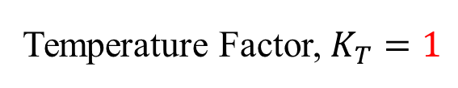
Temperature factor, $K_{T}$
Temperature Factor, $K_{T}=1$

Slide 22
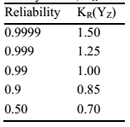

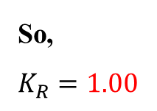

Reliability factor, $K_{R}$
For our problem,
$$Reliability=0.99$$
So,
$$K_{R}=1.00$$

Slide 23




BENDING FACTOR OF SAFETY, $S_{F}$
$${\left(S_{F}\right)}_{P}=\frac{S_{t}Y_{N}/(K_{T}K_{R})}{σ}$$
$$=\frac{(221.55)(0.919)/((1)(1))}{57.559}$$
$$=3.537$$
$${\left(S_{F}\right)}_{G}=\frac{S_{t}Y_{N}/(K_{T}K_{R})}{σ}$$
$$=\frac{(221.55)(0.936)/((1)(1))}{48.749}$$
$$=4.254$$

Slide 24
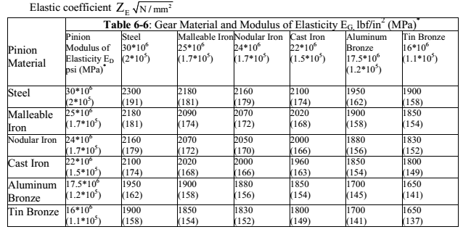


Elastic coefficient, $Z_{E} or C_{P}$
Materials
Gear : Steel
Pinion : Steel
$$Z_{E}=191$$

Slide 25


Surface Condition factor, $C_{f} or Z_{R}$
$$Surface Condition factor,Z_{R}=1$$

Slide 26
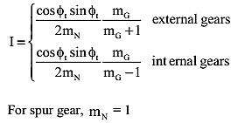



Geometry factor for pitting resistance
$$I or Z_{I}$$
For our problem,
$$Transverse Pressure angle,φ_{t}=20°$$
$$Speed Ratio, m_{G}=2.73$$
$$Z_{I}=\frac{\cos{20°\sin{20°}}}{2×1}×\frac{2.73}{2.73+1}$$
$$=0.118$$

Slide 27

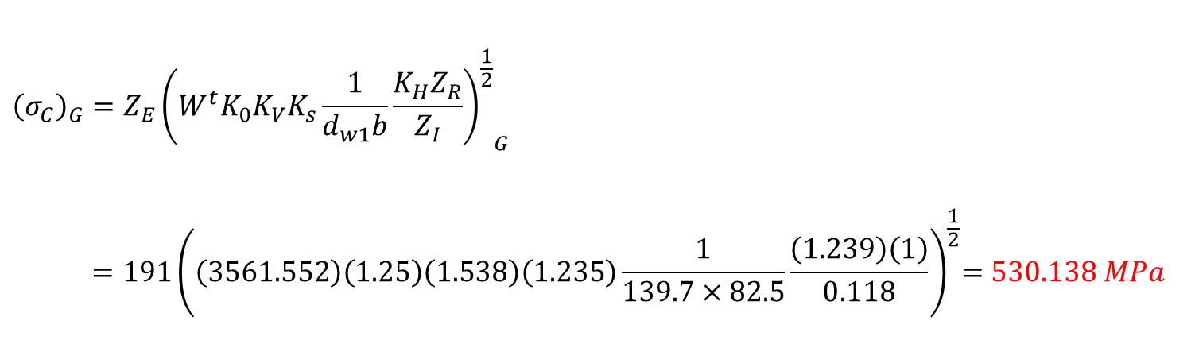

Gear Contact stress, $σ_{c}$
$${\left(σ_{C}\right)}_{P}=Z_{E}{{\left(W^{t}K_{0}K_{V}K_{s}\frac{1}{d_{w1}b}\frac{K_{H}Z_{R}}{Z_{I}}\right)}^{\frac{1}{2}}}_{P}$$
$${ =191\left(\left(3561.552\right)\left(1.25\right)\left(1.538\right)\left(1.227\right)\frac{1}{139.7×82.5}\frac{\left(1.239\right)\left(1\right)}{0.118}\right)}^{\frac{1}{2}}=528.418 MPa$$
$${\left(σ_{C}\right)}_{G}=Z_{E}{{\left(W^{t}K_{0}K_{V}K_{s}\frac{1}{d_{w1}b}\frac{K_{H}Z_{R}}{Z_{I}}\right)}^{\frac{1}{2}}}_{G}$$
$${ =191\left(\left(3561.552\right)\left(1.25\right)\left(1.538\right)\left(1.235\right)\frac{1}{139.7×82.5}\frac{\left(1.239\right)\left(1\right)}{0.118}\right)}^{\frac{1}{2}}=530.138 MPa$$

Slide 28


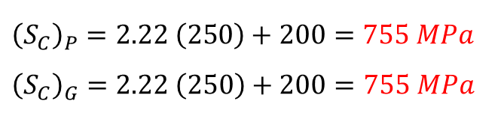
Repeatedly applied contact strength, $S_{C}$
Materials of Gears (both pinion and gear)
Through-hardened grade 1 steel
Brinell Hardness, $H_{B}=250$
$${\left(S_{C}\right)}_{P}=2.22 \left(250\right)+200=755 MPa$$
$${\left(S_{C}\right)}_{G}=2.22 \left(250\right)+200=755 MPa$$

Slide 29
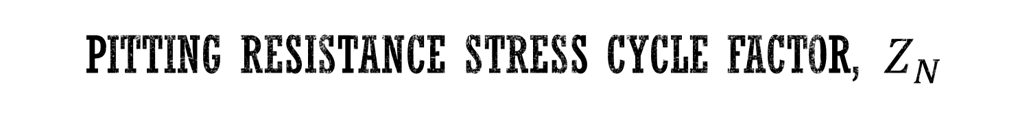
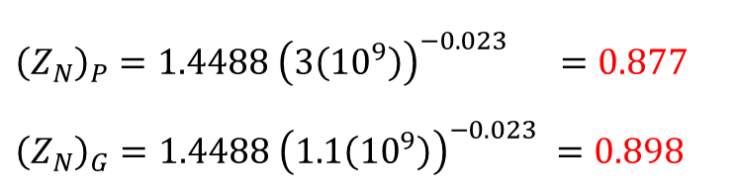
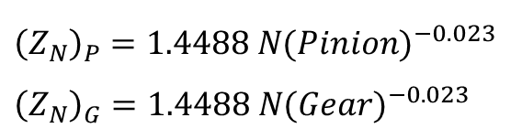
Pitting resistance stress cycle factor, $Z_{N}$
$${\left(Z_{N}\right)}_{P}=1.4488 {N(Pinion)}^{−0.023}$$
$${\left(Z_{N}\right)}_{G}=1.4488 {N(Gear)}^{−0.023}$$
For our problem,
$$N\left(Pinion\right)=3\left({10}^{9}\right) revolutions$$
$$N\left(Gear\right)=\frac{N\left(Pinion\right)}{m_{G}}$$
$$=\frac{3({10}^{9})}{2.73}=1.1\left({10}^{9}\right) revolutions$$
$${\left(Z_{N}\right)}_{P}=1.4488 {\left(3\left({10}^{9}\right)\right)}^{−0.023} =0.877$$
$${\left(Z_{N}\right)}_{G}=1.4488 {\left(1.1\left({10}^{9}\right)\right)}^{−0.023} =0.898$$

Slide 30




Wear FACTOR OF SAFETY, $S_{H}$
$${\left(S_{H}\right)}_{P}=\frac{S_{C}Z_{N}/(K_{T}K_{R})}{σ_{C}}$$
$$=\frac{(755)(0.877)/((1)(1))}{528.418}$$
$$=1.253$$
$${\left(S_{H}\right)}_{G}=\frac{S_{C}Z_{N}/(K_{T}K_{R})}{σ_{C}}$$
$$=\frac{(755)(0.898)/((1)(1))}{530.138}$$
$$=1.279$$

Slide 31


Conclusion
$${\left(S_{F}\right)}_{P}=3.537 ; {\left(S_{F}\right)}_{G}=4.254$$
$${\left(S_{H}\right)}_{P}=1.253 ; {\left(S_{H}\right)}_{G}=1.279$$
For the pinion,
Compare ${\left(S_{F}\right)}_{P}$ with ${{\left(S_{H}\right)}^{2}}_{P}$, i.e., 3.537 with ${1.253}^{2}=1.57$, so the threat in the pinion is from wear.
For the gear,
Compare ${\left(S_{F}\right)}_{G}$ with ${{\left(S_{H}\right)}^{2}}_{G}$, i.e., 4.254 with ${1.279}^{2}=1.636$, so the threat in the gear is also from wear.

Slide 32
THANK YOU

